Slide 1
Urban Analytics
Introduction to Urban Analytics with Python

Slide 2
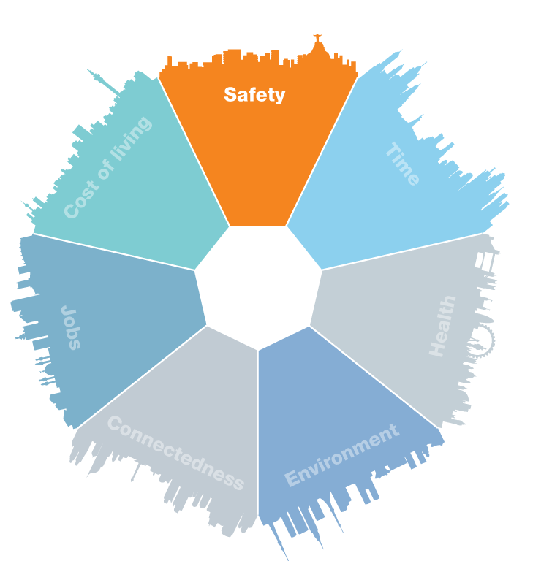
Urban Analytics
Multidisciplinary field with its roots in social sciences (urban planning, city design) that leverages advances in computer science and artificial intelligence
Utilizes the huge volumes of data generated by devices in urban environments to make intelligent decisions, communicate real-time information to workers and residents, and inform urban planning and policy making
Large-scale datasets can be combined and synthesized to gain insight into real-time events and inform future decision-making and policy
Aided by the proliferation of IoT devices, cameras and sensors that can communicate and transmit large volumes of data to databases and cloud storage for analysis and modelling
More important than ever as cities recover from the pandemic and transition to new, more environmentally friendly practices

Slide 3
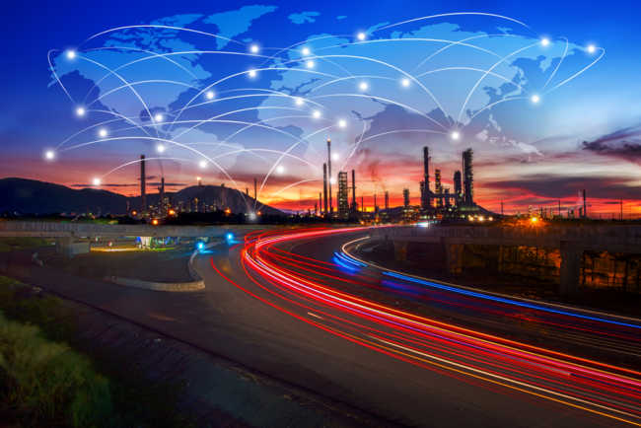
Applications
Smart buildings - connected devices in built environments detect patterns in daily activities; can be used to drive decisions
Air quality and pollution monitoring
Traffic monitoring and management - real-time reporting for residents, intelligent traffic lights, intelligent streetlights
Fault-reporting and maintenance - sensors can detect when critical infrastructure is close to failing, and can report on metrics such as temperature, voltage/current, etc
Security - crime prediction via trend analysis
Planning - best place for new roads, new parks, new bus stops, etc

Slide 4

Ethical Considerations
The danger of abundant surveillance of citizens - privacy rights
Data protection and governance - how to securely store and/or anonymize data
Dangers of policy-decisions on potentially incomplete data - biased in favour of particular race, gender, socio-economic status, etc
Data gaps among certain demographics - some residents may not be able to afford technology/connectivity
Lack of interpretability in predictions made by deep learning/machine learning models - “black box” problem

Slide 5
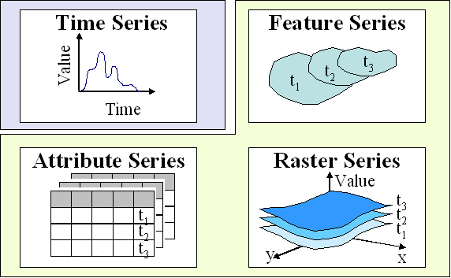
Types of data
Structured, tabular data - rows of observations consisting of multiple features (columns). An example might be observations from air pollution sensors
Time-series data - data that varies over time is very common in urban data
Unstructured data - data that is not arranged into a known, predefined structure. Examples include video data from cameras, audio data from microphones, and images
Geospatial data - data that has geographical features and types as a key component
Textual data - a form of unstructured data capturing raw text

Slide 6

Python
High-level, general-purpose programming language with intuitive syntax
30 years old - first release was in 1991
Has emerged as the main programming language in data analytics, machine learning and scientific computing in the past decade
Very commonly used for scripting, automation, image processing, web development and many other applications
Has excellent packages for integration with databases, caches, cloud platforms (AWS, Azure, etc), message queues/brokers and other types of data-driven infrastructure
Has excellent packages for data science, machine learning, data visualization, geospatial data and network/graph-based data

Slide 7
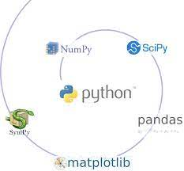
Urban Analytics
in Python
Python has many mature libraries to aid in urban analytics tasks.
Numpy - numerical computing library with an interface into C (very fast!)
Pandas - tabular analytics library
Matplotlib/Seaborn - data visualization and charting libraries
Scikit-learn - machine learning toolkit
PyTorch and TensorFlow - deep learning (neural network) libraries
GeoPandas - geospatial extension to Pandas
ArcPy - Python library that works with ArcGIS
networkx - network analytics library
Folium - interactive web-based mapping tool
Streamlit - dashboarding tool
… many more!

